Slide 1
Safe Disposal of Prescription Medications
FEHB Program Advisory Group
October 11, 2017
Dele Solaru, PharmD.,MBA
Chief Pharmacy Officer, Healthcare and Insurance

Slide 2
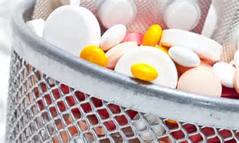
Why it is important to safely dispose of prescription medications
Prevents poisoning of children and pets
Deters misuse and potential diversion
Avoids health problems from accidentally taking the wrong medicine, too much of the same medicine, or expired medicine
Keeps medicines from entering streams and rivers when poured down the drain or flushed down the toilet

Slide 3
How to safely dispose of prescription medications
DEA authorized collector
Retail pharmacies
Hospital/clinic pharmacies
Law enforcement locations
National prescription drug take back day events – Law enforcement agencies
DEA Office of Diversion Control’s Registration Call Center at 1-800-882-9539

Slide 4
How to safely dispose of prescription medications
Take your prescription drugs out of their original containers.
Remove any patient identifiers on the empty container by covering it up or scratching it off
Put the mixture into a disposable container with a lid or into a sealable bag
Mix drugs with an undesirable substance, such as cat litter or used coffee ground
The sealed container with the drug mixture, and the empty drug containers, can now be placed in the trash
FDA Flush list – can be used for select medications in situations where a timely take –back program is not available
https://www.fda.gov/Drugs/ResourcesForYou/Consumers/BuyingUsingMedicineSafely/EnsuringSafeUseofMedicine/SafeDisposalofMedicines/ucm186

Slide 5
Questions?

