Slide 1
Welcome to the Legislative Training Seminar!
2013 SPAC Seminar
April 7th
Washington, DC
Notes:
Ladies and Gentleman, Welcome to the 2010 National Rural Letter Carriers’ PAC Seminar. My name is Elliot Friedman, and I look forward to working with you this coming year to make 2010 the best PAC year in our organizations history. Go around the room to introduce ourselves.

Slide 2
Seminar Agenda
Introduction
SPAC Basics
Ways to Give to SPAC
Responsibilities of SPAC advocates
Gifts and the “One Third Rule”
Automatic Contributions
Do’s and Don'ts
Fundraising Strategy
Ideas and Improvements
SPAC Contact Sheet
Notes:
Today’s Agenda: Elaborate on each point

Slide 3
What is a PAC?
A PAC stands for Political Action Committee.
It is a Lobbying Tool.
Supervisors PAC (SPAC) collects voluntary contributions from NAPS members.
SPAC aggregates contributions from its members into a central account so NAPS can legally contribute the campaign’s of legislators and candidates the fight for Postal Supervisors on Capitol Hill.

Slide 4
PAC Q & A
Q: Why is SPAC Important?
A: Candidates must raise money to conduct their campaigns, and by contributing to a candidate’s campaign, it becomes easier for our Legislative Team to educate Members of Congress on issues of importance to NAPS Active, Associate and Auxiliary members.
Q: How are contributions used?
A: PAC makes campaign contributions on a bi-partisan basis to candidates for the U.S. House of Representatives and U.S. Senate.
Q: Will my participation level have any effect on my NAPS membership?
A: No. SPAC funds are independent of NAPS funds, and SPAC contributions are not required for your NAPS Membership.

Slide 5
PAC Q & A
Q: What guidelines does the PAC follow?
A: SPAC follows the laws set by federal law and the rules in turn established by the Federal Election Commission.
Q: What factors are considered when choosing a candidate?
A: - Legislators who have supported NAPS endorsed legislation;
- Candidate Questionnaire
- Meet & Greet
- Committee Assignments
- Positions of Leadership within Congress
- Probability of getting elected or re-elected

Slide 6
Ways to give to SPAC
At a Meeting
Directly
Fill out an individual receipt with cash, credit card or check
Contribute to a group contribution with cash
Give a gift (in kind contribution) and fill out a receipt
Sign up for payroll deduction through PostalEASE
Sign up for a pension contribution through OPM
Contribute online via Credit Card
Mail a contribution to NAPS Headquarters with a check, money order or credit card information

Slide 7
Where Do We Fit In?
Our Objective: Raise as much as possible for SPAC!
National PAC Manager role:
File Monthly and Special reports with the FEC
Ensure all donations are in compliance with FEC rules
Manage the SPAC Database (VOCUS)
Manage Payroll Deduction Program (CCC)
Write Online Solicitations for SPAC
Plan the SPAC budget
Facilitate SPAC fundraising by members
A member in the fields role:
Raise funds for PAC
Provide detailed and accurate records to PAC Manger
Send contributions to national office in a timely manner
Repeat…
Notes:
These are my three primary responsibilities. However, primarily, my job is to help you. The better we work together, the more successful I have been.

Slide 8
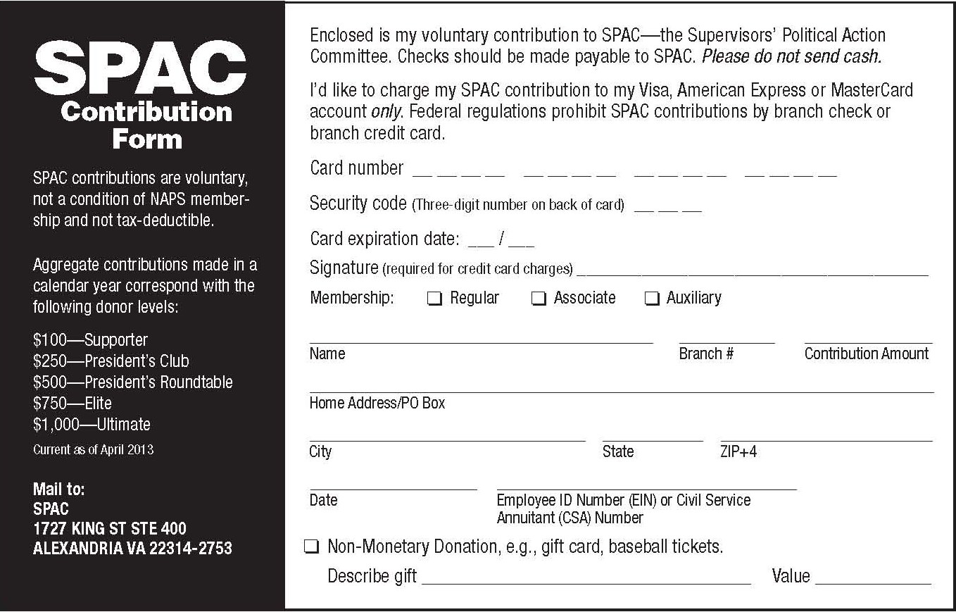
Good PAC Receipt
Contribution Amount
The branch where the receipt will be credited
EIN or CSA Number
In-Kind Contribution Information
Credit Card Information

Slide 9
Receipts for individuals
Please make sure to:
Neat and complete EIN, name, address, and branch
Make sure total on receipts match checks, money orders and credit card information given
No checks from corporate, farm, auxiliary, state, or branch accounts
Do not send cash
Do not collect money and write a personal check
Do not deposit PAC money into any account
All checks should be made out to SPAC
This form is available on the NAPS website in the SPAC portion of the Legislative Center
KEEP RECORDS!!!
Notes:
This is honestly the most important slide of my presentation today. If you please turn to the back of your books, there are examples of these receipts, and what I am looking for, and what I'm not. With the software the PAC uses, having money tracked this way makes my life so much easier for me and allows me to work faster and better for you.
50/50’s if someone does a fifty / fifty, not everyone has to have receipt. The winner can get credit, for the 50% going to the PAC, or you can pick a second winner gets the credit, while the first winner gets the cash.

Slide 10
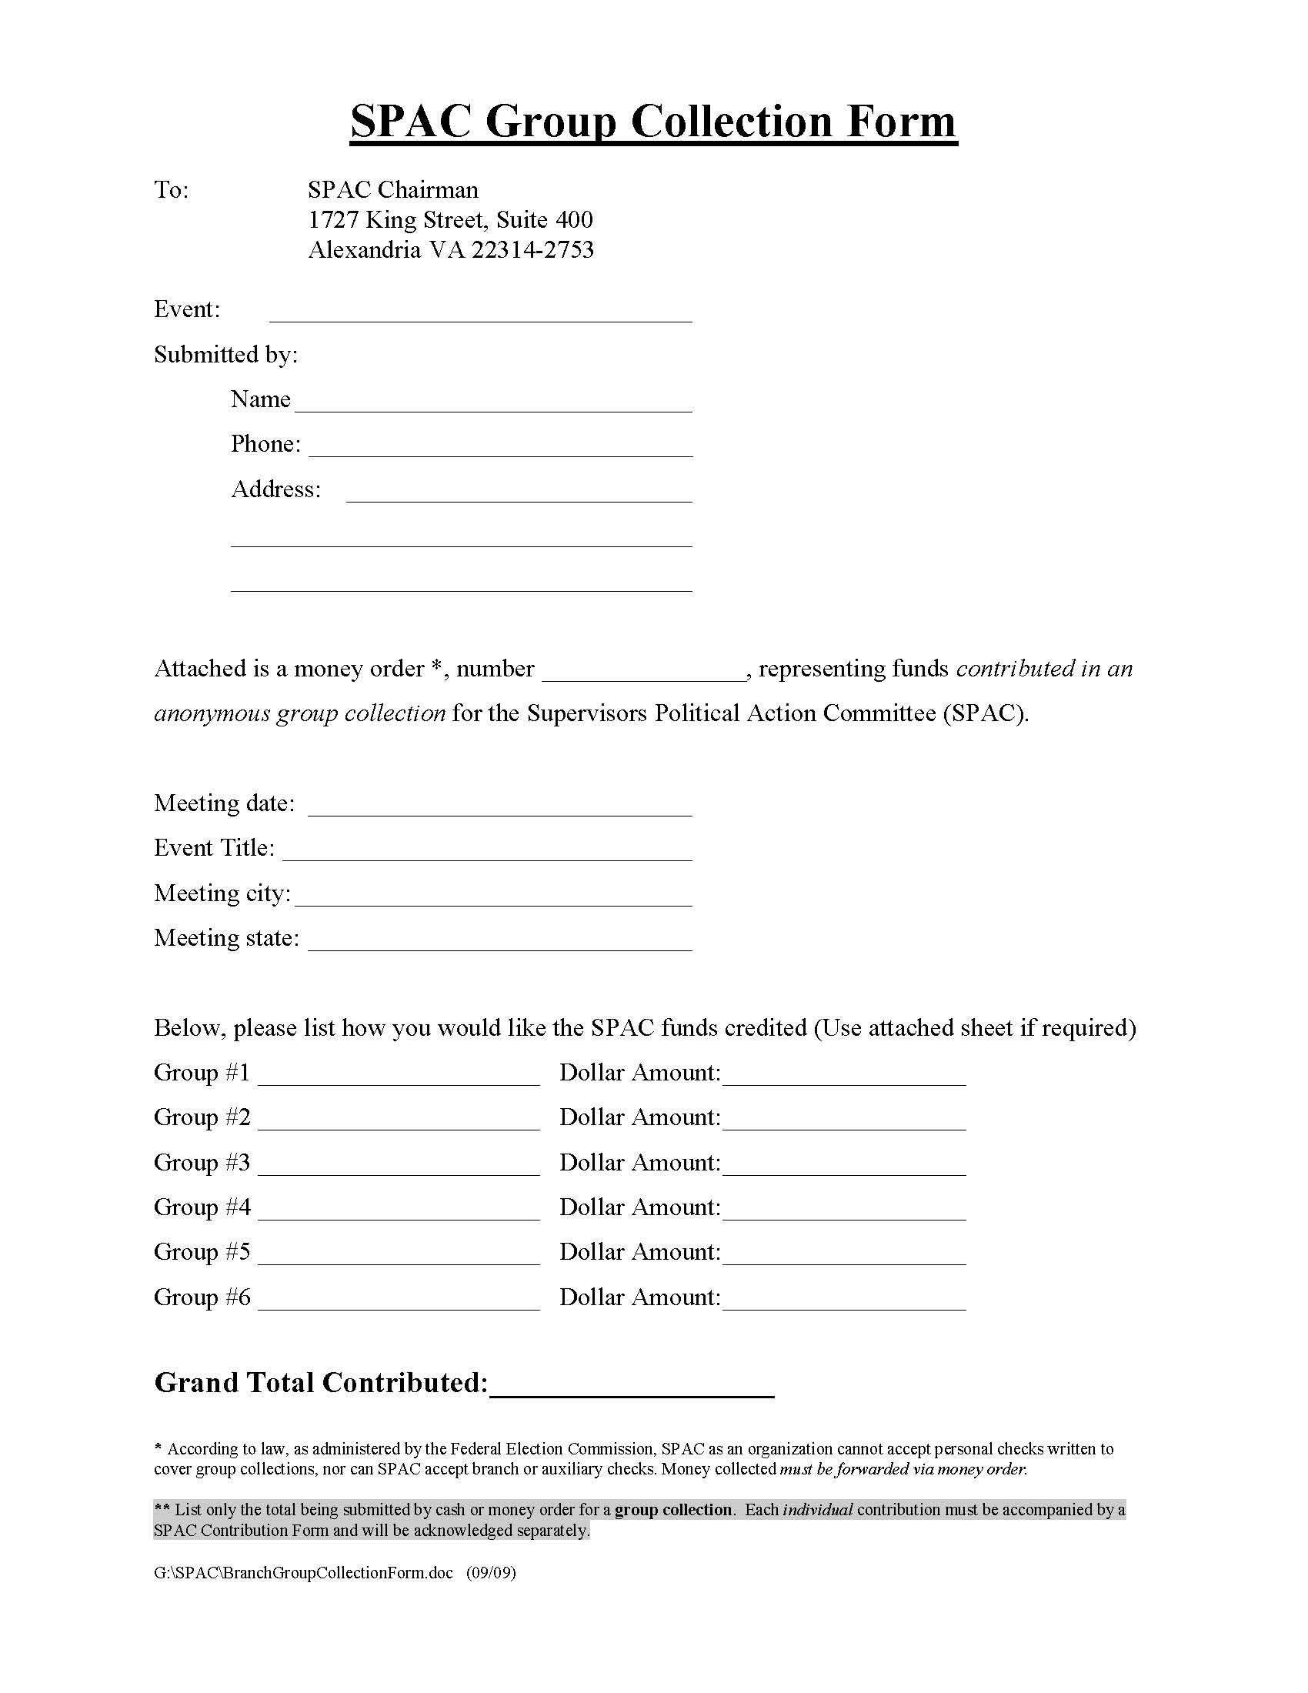
Good Group Collection Form
Group/Branch getting credit for the 50/50 or Pass the Hat
There should only be one money order that matches the dollar amount.

Slide 11
Group Contributions
Please make sure:
These should only be used for 50/50 raffles or a “pass the hat”
It is always better to use individual receipts allowing for both the individual and the branch to receive credit for a contribution
Only one money order should accompany each group receipt form
Money orders should be made out to SPAC
The fee for the money order cannot be taken out of the SPAC funds and is allowed to be reimbursed by a local or state branch
This form is available on the NAPS website in the SPAC portion of the Legislative Center
KEEP RECORDS!!!
Notes:
This is honestly the most important slide of my presentation today. If you please turn to the back of your books, there are examples of these receipts, and what I am looking for, and what I'm not. With the software the PAC uses, having money tracked this way makes my life so much easier for me and allows me to work faster and better for you.
50/50’s if someone does a fifty / fifty, not everyone has to have receipt. The winner can get credit, for the 50% going to the PAC, or you can pick a second winner gets the credit, while the first winner gets the cash.

Slide 12
Step Three: Maintain Records
Sample Records Spreadsheet
EID Number | Name | Event Donation Made | Donation Amount | Date of Donation | Preferred Contact
08172000 | Elliot Friedman | Area Training | 100 | 08/01/12 | Naps.ef@naps.org
07041776 | Jovan Duncan | State Convention | 500 | 09/05/19 | steelersrock@aol.com
02365448 | Seth Lennon | Branch Meeting | 750 | 08/02/10 | NittanyLionOne@gmail.com
04271983 | Bailey Anderson | Holiday Party | 201 | 08/03/10 | (703) 836-9660

Slide 13
Second Step: Sending in PAC Money
Please double check your totals
Individual contributions and Group Contributions are supposed to be deposited in the SPAC bank account within 10 days of a contribution being made
Please do not delay in sending contributions in to National Headquarters
Notes:
Please turn two pages back in your binders. This is also incredibly important. If these numbers don’t add up, I cannot deposit the checks.
All Match up
All separated
All alphabetized
Most importantly, the more the better. Smaller remittances or batches are quicker to enter and double check than bigger batches. Frequent ones with 100-200 are just as good if not better than one with 1500 dollars.

Slide 14
Step Three: Account Managment
PAC Manager opens letter and verifies totals
Receipts are entered into database
Checks are endorsed
Money is deposited at the bank
Receipts, VOCUS generated report, and bank receipt are filed
Reports for The Postal Supervisor are generated on the 1st of a month for the previous month, and are entered in the following month’s magazine
Notes:
This is what I get to do everyday.
Special note: magazine names area month later then when they get in. If Mary Sue gets ruby status, first it has to get to me. Second it has to be entered. It gets done the fifth of the next month. And will appear in the magazine a month after that. Because of the length of this process, it again highlights the need to send remittances more often, even if they have less money.

Slide 15
Your Responsibilities as Branch Official
Raise PAC funds
Maintain accurate records for donations with a year-to-date spreadsheet
Research and stay informed on Political/Legislative issues

Slide 16
Individual Gifts/In-kind Contributions
As an individual, you are allowed to donate a gift to SPAC, that SPAC can then use to raise money.
The fair market value of this gift counts against your annual $5000 donation limit.
By giving a gift to SPAC and filling out a receipt, it counts towards your donor level as if you had given a cash contribution for the same amount.
On the receipt, please describe the gift and give its value.
Examples of in-kind contributions for raffles can range from gift certificates, knitted quilts or sports tickets.

Slide 17
What is the “One Third Rule?”
National, State and Branch organizations are allowed to use branch funds to buy a gift to SPAC, that SPAC can then use to raise money (this gift cannot be cash).
The “One-Third Rule” allows a component of NAPS (such as a branch) to spend money on raffle prizes and door prizes, as long as the money spent is valued at no more than one-third of the proceeds that are sent to SPAC.
For example, if a local branch spends $100 on an autograph baseball and auctions it off for SPAC, the raffle must raise at least $300.

Slide 18
Withholding & OPM Contributions
Payroll Deduction:
Currently available for active members through PostalEASE
An automatic payroll deduction deposited directly into the PAC account
Bi-weekly
Members sign up through PostalEASE (phone or online)
OPM Deduction:
Available for retirees to contribute through their OPM Pension
An automatic pension deduction deposited directly into the PAC account
Monthly
Members sign up through Postal-Ease (phone or online)
Notes:
This is very important. The more members we get signed up to give automatically:
Fewer bounced checks
More money for us
Less work for you
You only are allowed two withholding as you know, but as far as we go, they are interchangeable from the PAC perspective.

Slide 19
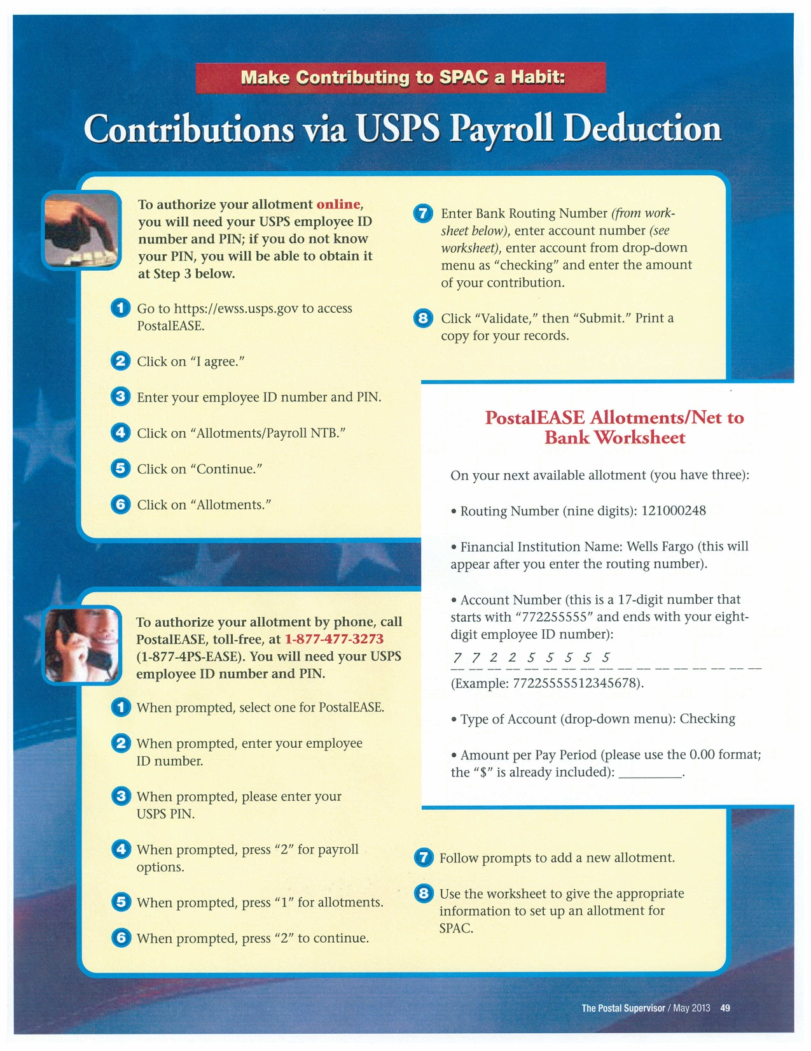

Slide 20
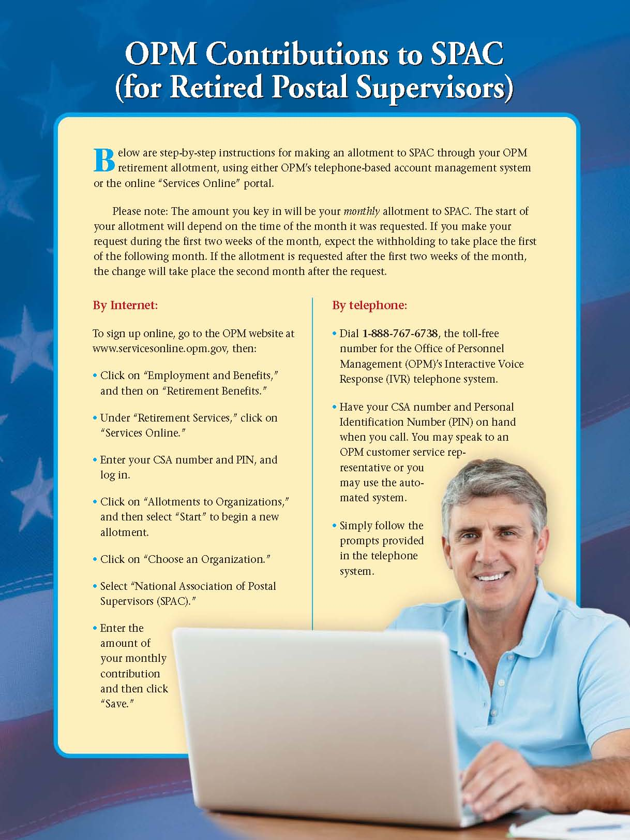

Slide 21
Continuous Contributor Club
A new system designed to recognize and reward the importance of recurring contributions through PostalEASE and OPM Payroll Deduction
Includes a New Pin for only those who participate
Names of Participants will appear in a special section of The Postal Supervisor
Special Raffles during the year for CCC Members
Instructions can be found online and in The Postal Supervisor

Slide 22
SPAC Do’s and Don’ts
Do:
Have Individual Receipts, Group Contribution Forms and Withholding Instructions for every meeting you attend
Issue receipts for all contributions
Make sure all receipts are neat and legible
Make sure all checks/money orders are made out to SPAC
Make sure all in-kind contributions are given a receipt and that it reflects the FAIR Market value and not its auctioned value
Make sure monetary contributions and receipts match
Send collected SPAC donations to NAPS HQ immediately
Do Not:
Deposit PAC contributions into any bank account
Accept business, farm or association checks
Use PAC contributions for money order fees
Use PAC donations for tax deductions
Take Cash and write a personal check to PAC

Slide 23
SPAC Pins
$100- $249.99 Supporter
$250- $499.99 President’s Club
$500-$749.99 President’s Roundtable
$750-$999.99 Elite
$1000 - $5000 Ultimate
Notes:
Just explain it.

Slide 24
Fundraising Ideas
Auctions*:
Straight Auction
Silent Auction
Drawings
Fun Events:
Casino Night
Sporting Events
Dunk Booths
50/50
Pass the Hat
Head to Head Competitions
Email Solicitations
* States have different laws as to what is permitted when raising funds for PAC

Slide 25
Goals and Best Practices
Set high but attainable goals
Automatic contributions (Withholding)
Value long time donors
Branch out to different groups of members and new members
Delegate
Compete and Incentivize
Regional, Head to Head, National
Get Out There! Attend or send a representative to local and state meetings
Notes:
No such thing as too much, and always shoot for the moon, but by setting incremental and attainable goals, you will accomplish them. One bird in hand is better than two in the bush.
EFT and withholding. 2-3 thousand a month that way. Could be 5 thousand easily, ten if we put a little elbow grease into it.
Thank your loyal members often.
Work to introduce and develop new relationships with those who have not donated
Delegate. Rita King is the king of this.
Compete – Make it fun, everyone wants to win, but just by playing, we all win.
90% of success is showing up.
Your part of a team, utilize your resources well.

Slide 26
What can we improve upon?
Best form of communication?
Who is giving, and how?
What has worked? What has not?
How Can I help you?

Slide 27
Questions????
Please fill out your SPAC Communication Sheet

